Slide 1

Security+
Exam SY0-601
Chapter 31
Security Controls
Notes:
Gain Attention

Slide 2
Chapter 31 (Domain 5.1 ) Learning Objectives
Compare and contrast various types of controls.
Category
Managerial
Operational
Technical
Control type
Preventive
Detective
Corrective
Deterrent
Compensating
Physical

Slide 3
Security Controls
Security controls are the mechanisms employed to minimize exposure to risk and mitigate the effects of loss.
Using the security attributes of confidentiality, integrity, and availability (CIA) associated with data, it is incumbent upon the security team to determine the appropriate set of controls to achieve the security objectives.

Slide 4
Categories
Three categories of security controls:
Managerial
Managerial controls are those that are based on overall risk management.
These security controls focus on the management of risk or the management of the cybersecurity system. The use of cybersecurity audits is an example of a managerial control.
Upper-level management
Operational
An operational control is a policy or procedure used to limit security risk.
These security controls are primarily implemented and executed by people, as opposed to systems.
Example: Physical security
Technical
The use of automated technology to enforce security
Example: Firewalls, IDS/IPS, biometrics etc.

Slide 5
Control Types
Controls can also be categorized by control type.
Controls can fit into multiple types, depending on deployment and use.
A door lock is an example of both a physical control and a preventative control.

Slide 6
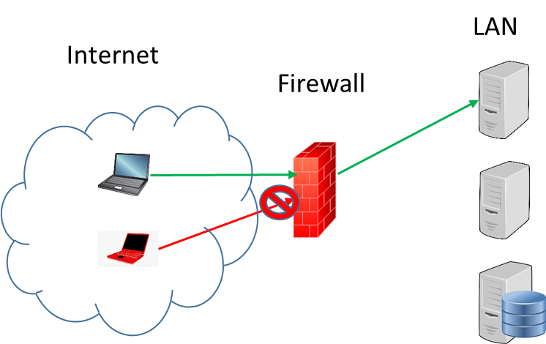
Control Types
Preventative
Firewall
Both a Technical control and a Preventative control
Hardware-based or software-based
Works on a set of rules defined by the administrator

Slide 7
Control Types
Detective
Facilitates the detection of a security breach
Can be physical or technical
Alarms
Intrusion Detection System (IDS)

Slide 8
Control Types
Corrective
Used after an event
Minimize the extent of damage
Load balancer
Data backups

Slide 9
Control Types
Deterrent
Discourage the attacker
Signs
Login banner
Laws and regulations
Increased punishment
Increased risk

Slide 10
Control Types
Compensating
Used to meet a requirement when no control is available
Fire suppression systems
Quarantine by anti-malware program

Slide 11
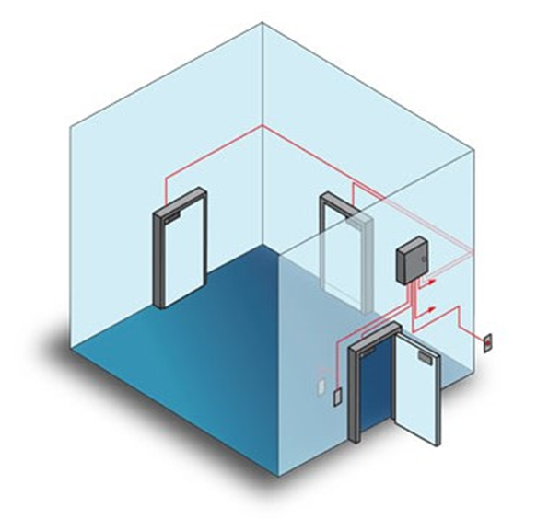
Control Types
Physical
Prevents specific physical actions from occurring
Mantrap

Slide 12
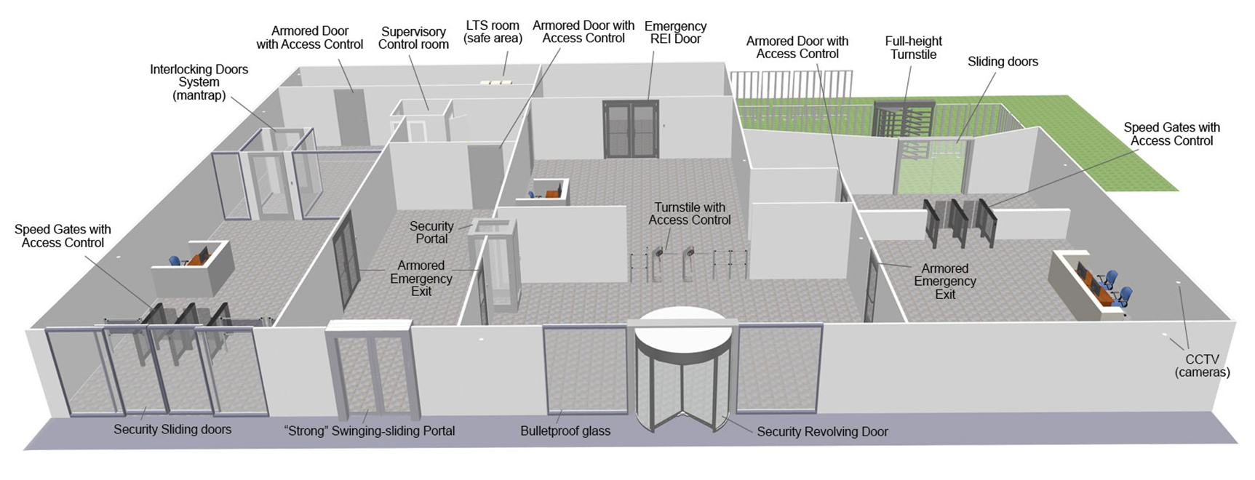
Control Types
* - Image not in book

